Slide 1
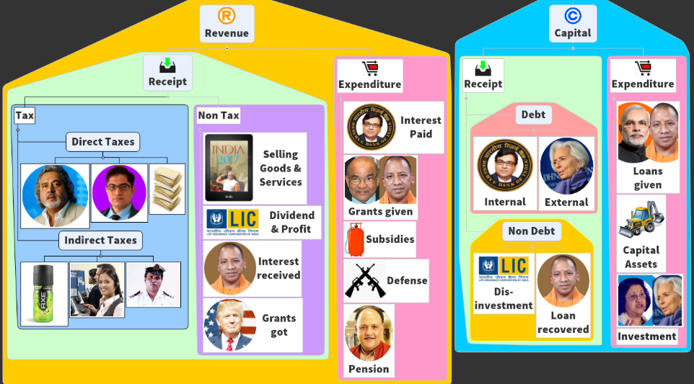
Budget ► Revenue ► Receipt ► Tax
This we’ll start

Slide 2
Adam Smith 4 canons
Good tax system
Canon of Equality: Proportionate to income.
Canon of Certainty: about deadline and rates.
Canon of Convenience: to the tax payer.
Canon of Economy: collection cost should be minimum. (i.e. staff salary, DBM)

Slide 3



Direct taxes of Union: Yellow = Gone
On Expenditure
Fringe Benefit (Pranab)
On Assets, Property, Capital transactions
Income tax;
Interest tax (on banks)
Hotel Receipt Tax
STT;CTT
Wealth Tax (Jaitley’15)
Banking Cash transaction tax [Chidam: ‘05-‘09]
Estate Duty (VP Singh)
Gift Tax (Yashwant)
On Income
DDT @Co. [@source]
CGT @Buyer [@Destination]
Corp. Tax & MAT
convenience?
Economy?
Certainty?
Notes:
Finance Minister P Chidambaram in 2005 had first brought 0.1 per cent levy on "withdrawal of cash on a single day of over Rs 10,000 or more from banks.

Slide 4

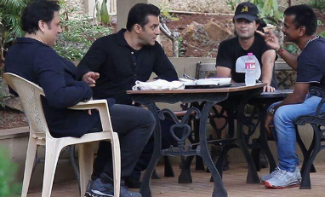




Direct Tax
Indirect Tax
Hotel receipt tax
Service Tax
Amount+ Service tax
Fringe Benefit Tax
Service Tax
Gym membership fees
+ service tax
Salary + Fridge Benefit (gym membership)
TAXES ON EXPENDITURE

Slide 5
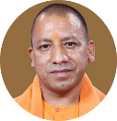



Direct Taxes of the State governments?
On Income
Agriculture Income tax
Professional tax
On property
Land Revenue
Stamp/Registration duty
Property tax in urban areas
Art.276: state/LocalG. (Max 2500. 14th FC says raise to 12k)

Slide 6
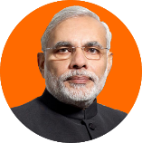
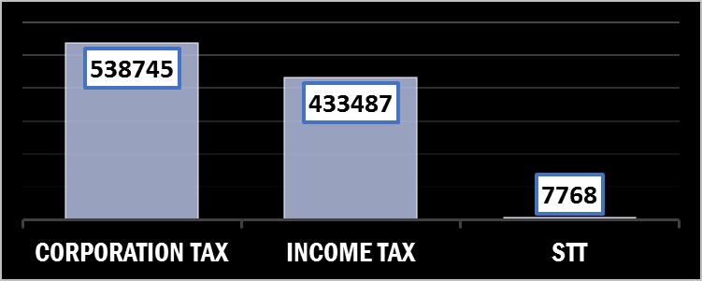

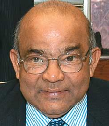
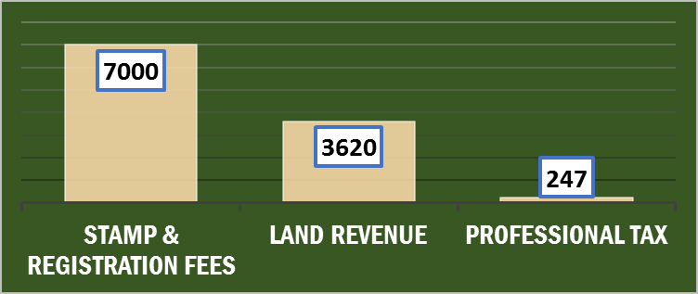
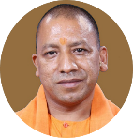



Budget 2017: Direct taxes (crores)
REMEMBER The Decreasing Order
+ DT from UT without Legislature
42% Tax
Cess
Surcharge
Horizontal Distr. Variables:
1) Census 1971: Population
2) Census 2011: Demographic Change
3) Income-Distance from Best States
4) Area
5) Forest-Cover
Gujarat State Budget 2017
UP 18%
Absolute figures important in exam?
UPSC No; SSC, IBPS, State-PSC= Yes.
Guj 3%
How is this horizontal devolution decided? 14th FC

Slide 7
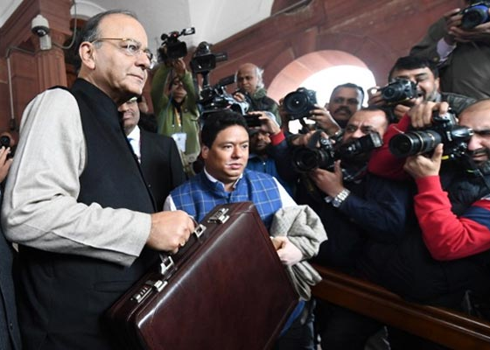
Direct Tax: प्रत्यक्ष करों के फायदे व् नुक्सान
Merits
Progressive (richer person higher tax)
Demerits
Collection expensive (staff salary, database Management). Therefore, Narrow base.
Inequality of income …reduced
Certainty (when and how)
Elasticity, quick results when raised / lowered.
Externality not counted: Tata [30%] vs film star promoting cigars [30%].
Hardship not counted: working Carpenter [5%] vs sleeping landlord [5%]
High level of direct tax► laziness, less foreign investment
► litigation, avoidance using loopholes esp. CGT. <more in black money>
To encourage Savings & investment: tax deduction- exemptions can given [e.g. if NPS/PPF ** deduction]

Slide 8
Direct Taxes in Budget 2017
Not for CA exam.
Black Money in separate lecture.

Slide 9
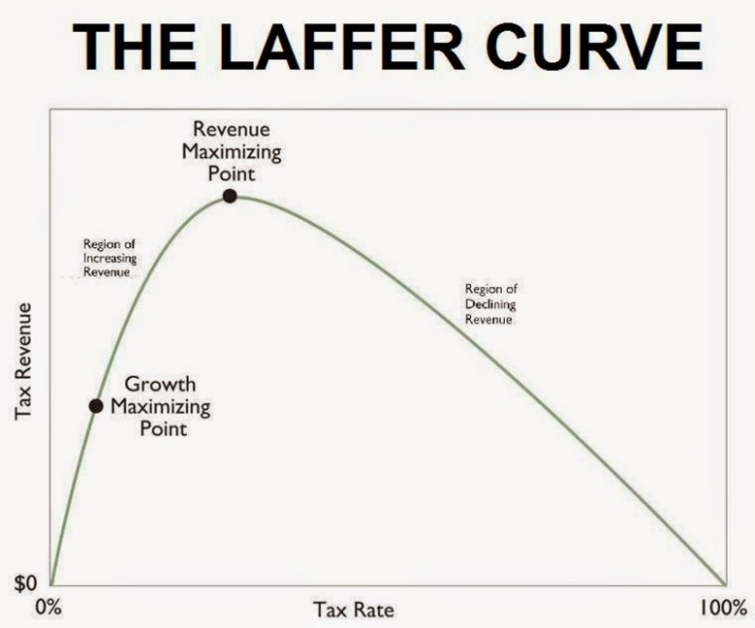

Fiscal Policy: Direct Taxes and Laffer Curve (Arthur Laffer, US)
$10 bn
$1 bn
No incentive to work! ☹
0 billion
0%
15%
60%
100%
Notes:
Though he says he did not invent it.

Slide 10
Mock question
According to “Laffer Curve”, as the income tax rate is increased, the amount of revenue collected ___
Will Increase for a developed country, but will decrease for a developing country.
Initially Increases and then starts to decrease after a peak point.
Decreases and then starts to increase after an ebb point.
None of the above.

Slide 11
Laffer (PHD) : Direct Taxes: lower “rates” = higher revenue
Trump 2017
IT Top Rate: 39.6%-> 35%
Modi 2017
IT 10%->5%
MSME: 25% [50 cr.]
Future Corporation Tax: 30%->25%
Corporation Tax: 35%->15% [exemption, deduction]
Critiques: Fiscal deficit
Trump: “Offshore biz & outsourcing” ☹

Slide 12


Budget-2016: individual income tax?
Taxable Income | Individual (below 60 age) | Senior citi. (60 to <80) | Very senior (80/>)
Upto 2.5 lakh | NA | NA | NA
>2.5-3lakh | 10%
>3-5 lakh |  | 10%
>5-10 | 20% | 20% | 20%
>10 | 30% | 30% | 30%
>1 Cr. | 30% tax + 15% surcharge on that tax
3% edu. Cess on ALL: (Tax + Surcharge)

Slide 13
Budget-2017: individual income tax?
Income slab | Individual (below 60 age) | Senior citi (60 to <80) | Very senior (80/>)
Upto 2.5 lakh | NA | NA | NA
>2.5-3lakh | 5% 10%
>3-5 lakh |  | 5%
>5-10 | 20% | 20% | 20%
>10 | 30% | 30% | 30%
50L to 1 Cr. | 30% tax + 10% surcharge on that tax [Eff.33%] This surcharge ~2700 cr.
>1 Cr. | 30% tax + 15% surcharge on that tax [Eff.34.5%]
but 10% -> 5% = 15,500 cr. Tax “FOREGONE”
3% edu. Cess on ALL: (Tax + Surcharge)

Slide 14
Budget 2016 for UPSC not CA
Gross income
5 lakh
Minus Deduction, Depreciation, Exemptions
Taxable income
MINUS Rebate Rs.5000
Agriculture income
80/C: LIC, PPF etc. upto 1.5 lakh
80E: Edu Loan
80EE: Home Loan interest
Welfare fund…
80GG: House rent
Rs. 3,50,000
2,50,000 = 0%
1,00,000= 10% = Rs.10,000
Tax payable= 5,000
PLUS Surcharge = 0
PLUS 3% Cess [Tax + surcharge] = 150
Total = 5150
Taxable income
Upto 2.5l=0%
Above upto 5l=10%
Taxable income upto Rs. 5 lakh
Then Rs. 5000 rebate
2%: primary
1%: secondary + higher

Slide 15
Budget 2017: small tax payer
Gross income
5 lakh
Minus Deduction, Depreciation, Exemptions
Taxable income
MINUS Rebate Rs.2,500
Like last slide..
3,50,000 rupees
2,50,000 = 0%
1,00,000= 5% = Rs.5,000
Tax payable= 2,500
PLUS Surcharge = 0
PLUS 3% Cess [Tax + surcharge] = 75
Total = 2575
Taxable income upto Rs. 3.5 lakh
Then Rs. 2500 rebate
TDS simplification etc. black money

Slide 16

Budget 2017: HNI? अमीरों पर आयकर
Taxable income
60,00,000
2.5L=0%
0
2.5L=5%
15,00,000
12500
5L=20%
1,00,000
REM 50l 30%
Total
16,12,500
Goes to CFI, FC shares
Total Tax
16,12,500 -Rebate 0
+ 10% surcharge
1,61,250
+ 3% Edu Cess [Tax + Surcharge]
53,213
FINAL:
18,26,963
0-2.5
>2.5 to 5 lakh
Goes to CFI, no specific purpose FC can’t share
>5- 10 lakh
>10 lakh
Edu Cess: Prarambhik Shiksha Kosh, Public Account, Specific purpose , FC can’t share

Slide 17
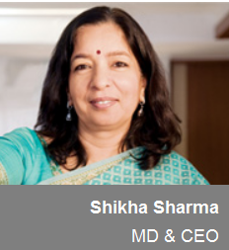
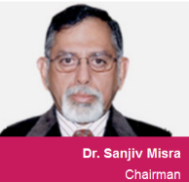


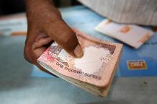

Dividend distribution tax (DDT) since 1997
PROFIT
Board of Directors
DIVIDEND-15% DDT(@source) + 12% surcharge + 3% edu cess
SHARE-HOLDERS
TATA Trust
Zydus Family Trust
Budget 2016: If >Rs.10 lakh dividend, addl.10% Tax (@destination) Individual, HUF, Partnership firms
Budget 2017: + Trusts also
Notes:
http://economictimes.indiatimes.com/markets/stocks/news/budget-2017-dividend-tax-shocker-for-family-trusts/articleshow/56928190.cms
Dividend has to be distributed acc. To shareholding
How can Biyani make more than his share holding? Ans. Royalties!
http://blog.wealtharchitects.in/2017/02/dividends-taxed-through-distribution-tax.html

Slide 18

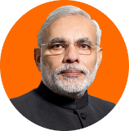
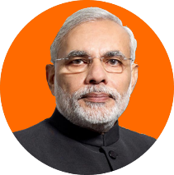

Taxability
Even here also 10% tax if> 10 lakh dividend [@Destination]
Income Tax @destination
Dividend distribution tax
@source
Remaining amount
Rs. 7.60
5% TDS
Equity (100) Share
Debt (100) Bond @8%
@Rs.8 Interest
Capital [200]
@Rs. 10 dividend

Slide 19
Statutory Corporation Tax in 2015: “30%” on profit + cess, surcharge etc.
Company
Profit <1 cr.
Profit >500 cr.
Effective Tax?
30.26%
25.29%
Because big companies claim larger deduction, exemptions on R&D, Assets etc. 150%
1/4/2017..phasing out of exemptions till 2020
Statutory corporation tax will be reduced to 25%
Eco. Survey said “fast tract” this thing.

Slide 20
Corporation Tax: Simplified, incentivized…
Budget 2016: Desi co.
25%: MFG After 1/4/16
29%: Turnover upto 5 cr.
30%: others
Budget 2017
25%: turnover upto 50 cr.
30%: others.
~7200 cr. Revenue foregone but excise ☺
Foreign Companies: 40%
+3% edu. Cess on (tax + surcharge)

Slide 21

Banking ltd. Company also has to pay corporation tax
Direct Tax
Allowable provision: NPA increased from 7.5% to 8.5%. = will reduce the tax liability of banks.
I propose to tax interest receivable on actual receipt instead of accrual basis in respect of NPA accounts of all non-scheduled cooperative banks also at par with scheduled banks.
This will remove hardship of having to pay tax even when interest income is not realized.

Slide 22
Startups
Direct Tax
Budget 2017
tax-exempted start-ups to allow them to carry forward losses even after original promoters reduce their holding to below 51%.
Also, the profit-linked deduction available to the start-ups for 3 years out of 5 years is being changed to 3 out of 7 years.
Budget 2016:
No Capital gains Tax on Startup investors **
10% tax on their royalty income from abroad, if Patented in India
100% deduction of profit for first three years but MAT will apply in such cases.

Slide 23
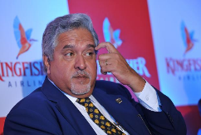
Minimum alternate Tax
Direct Tax
Companies use deduction, exemptions to become “Zero profit companies” & escape tax liability
1987: Rajiv:- Min. Corp.Tax
1996: Chidambaram- MAT
MAT: 18.5% on book profit
Budget 2016: no MAT on foreign company FII, FPI if they don’t have place of business in India. [SC Castleton investment case & Justice AP Shah]
Budget 2017: not possible to reduce or abolish MAT at present. Timelimit for MAT credit increased from 10 years to 15 years

Slide 24
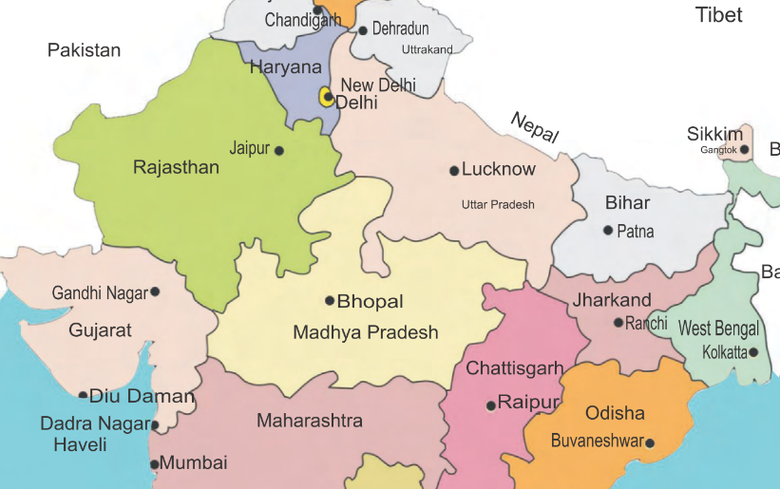



Capital Gains tax: direct tax on profit made from sale of assets
Short term 15%
Long term 20%
How long I held the asset before selling?
Threshold: 1-3 years | type
WITHHOLD CGT
& Pay to Govt.
Excluded
Personal effects, movable property, Jewelry, Archaeological collection, painting, sculpture, agri-land, gold/defense bonds and allied schemes of 80s and 90s.
3 % Edu Cess: yes
Individual: 15% surcharge if >1cr. Income.
Corporate surcharge: 7%: 1to 10 cr. ; 12% if >10cr.

Slide 25

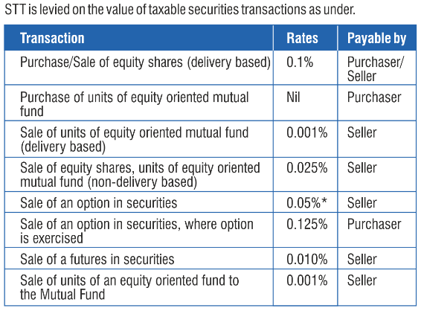
Securities transaction tax (STT): 0.001% to 0.125%
Commodity transaction Tax (CTT)
WEF 2013
Payable by seller
On Exchange traded commodities

Slide 26
Direct taxes of Union: Yellow = Gone
On Expenditure
Fringe Benefit (Pranab)
On Assets, Property, Capital transactions
Income tax;
Interest tax (on banks)
Hotel Receipt Tax
STT;CTT
Wealth Tax (Jaitley)
Banking Cash transaction tax
Estate Duty (VP Singh)
Gift Tax (Yashwant)
On Income
DDT @Co.
CGT @Buyer
Corp. Tax & MAT

Slide 27
Budget ► Revenue ► Receipt ► Tax

Slide 28


Specific Tax per “unit” Rs. 10 vs Ad Valorem 10%
Value: Rs. 20 x 5 cup = Rs.100
Value: Rs. 20 x 5 cup = Rs.100
Tax Rs. 10 per unit x 5 = Tax Rs.50
Ad valorem
As economy grows, revenue will grow. ‘inspector-raj’, frequent revision not necessary.
10% of value = Rs.10
Value: 1 litre pack = Rs. 100
Value : 1 litre pack = Rs. 100
Tax Rs. 10 per unit x 1 = Tax Rs.10
10% of value = Rs.10

Slide 29
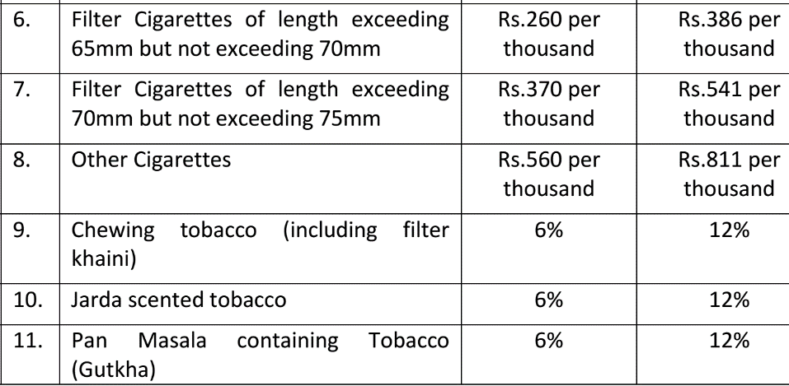
Excise duty in budget 2017
Specific Tax per unit
AD-Valorem

Slide 30
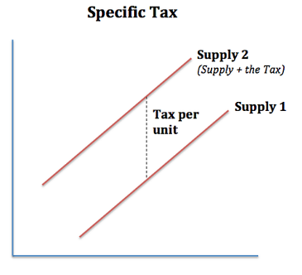
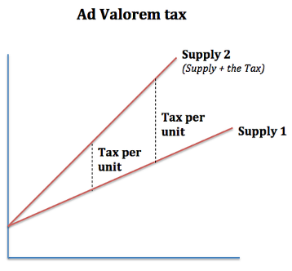
Price
Price
Quantity “UNITS” supplied
Quantity supplied
Supply line is Parallel
Supply line is not

Slide 31
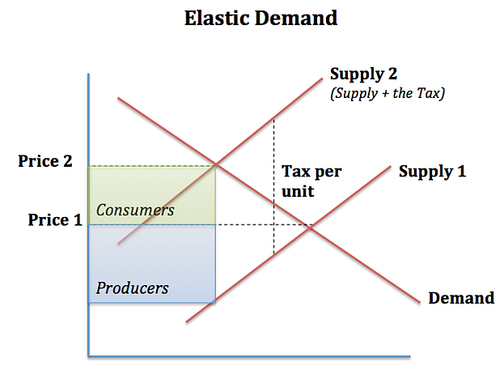

Why cigarettes have specific tax on quantity, rather ad-valorem?
Statutory incidence
Excise: Producer
Economic incidence
Shared by producer & customer (more)
20
200
Price
100
40
Quantity “UNITS” supplied

Slide 32

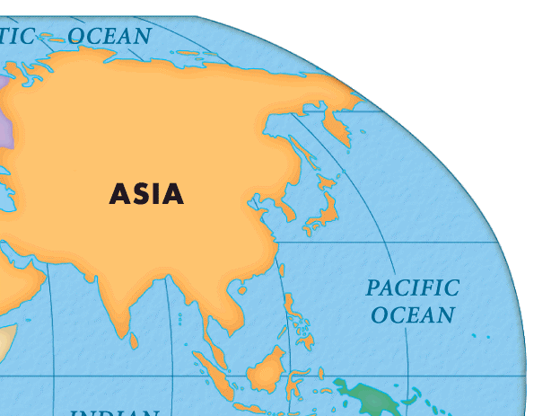


Custom duty (on import and exports)
impose additional custom duty
= countervailing Duty
China domestic market = Rs.106
Indian market = Rs.60 =
Custom duty + Dumping duty
Thai domestic market
Rs. 60 for 100 ml.
Custom 12%= 67 rs.
Duty inversion:
Imported Finished good = 12% custom duty
Domestic: Raw, intermediate material various tax + excise = finished product is expensive.
Desi coconut= just eat, don’t do “value addition” [of turning it into hairoil.]
Value Rs. 100 for 100 ml.
6% excise= 106 rs.
Notes:
May be because of subsidy or productivity ?

Slide 33



Indirect Taxes -> Union
Union
Custom Duty
Excise Duty
Service Tax
CST [00]
Basic
Additional
Petroleum
Alcohol , Narcotics
Others
Tobacco
CVD
Sp. Additional
IF Medicine or TP
+ Cess
Surcharge on these things
To counter balance foreign products vs. deshi products (VAT, excise…)
When GST council decides
Until then Excise + State VAT:
GST + Excise also
Red matlab REMOVED UNDER GST
Notes:
Since the States are not empowered to levy any tax on the sale or purchase of goods in the course of their
importation into or exportation from India, the Centre levies and collects this tax as additional duties of customs, which is in addition to the Basic Customs Duty. This additional duty of customs (commonly known as CVD and SAD) counter balances excise duties, sales tax, State VAT and other taxes levied on the like domestic product.

Slide 34

Indirect Taxes -> STATE
+ Cess
Surcharge on these things
State
Selling= VAT
Excise on Liquor, Narcotics
PURCHASE Tax
Entertainment
-NOT medicinal, toiletry prep.
UNION
-NOT TV, Radio, Newspaper
UNION
Advertisement
Petroleum
Vehicle, Animal, boats.
Luxury
Tolls, Transport, Entry Tax /Octroi
Betting-gambling
IF taken by Local Bodies
IF taken by Local Bodies
-NOT Newspaper
UNION
Electricity (?)
Transmission, Distribution, Sale
“Road TAX” (?)
When GST council decides
“DESHI”
Red matlab REMOVED UNDER GST
Notes:
http://energy.economictimes.indiatimes.com/news/power/electricity-should-be-included-in-gst-regime-ieema/56447141

Slide 35
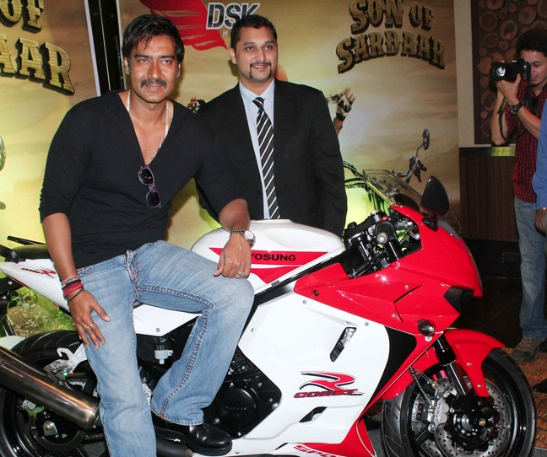
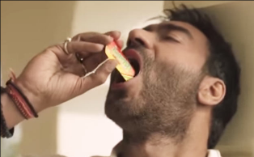

Indirect Taxes: GST will subsume all indirect taxes EXCEPT..what DEVGAN touches
Bike import Custom Duty*
Petroleum-import (Custom)
Petrol: Excise-VAT
(till GSTC notifies)
GST+ Central Excise
STATE EXCISE
+ Local bodies assigned
We’ll see in more ‘refined manner with caveats’ in next lecture on GST

Slide 36
Mock question
Ad Valorem Taxes are:
Expressed in absolute figure against the number of units produced.
Are kept out of the GST regime.
Are regressive in nature but have a very narrow tax base.
Answer choices
Only 1 and 2
Only 2 and 3
Only 1 and 3
None of them

Slide 37
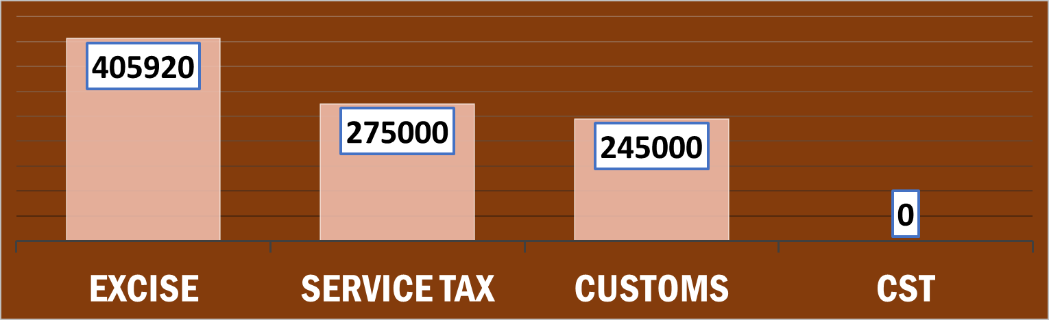



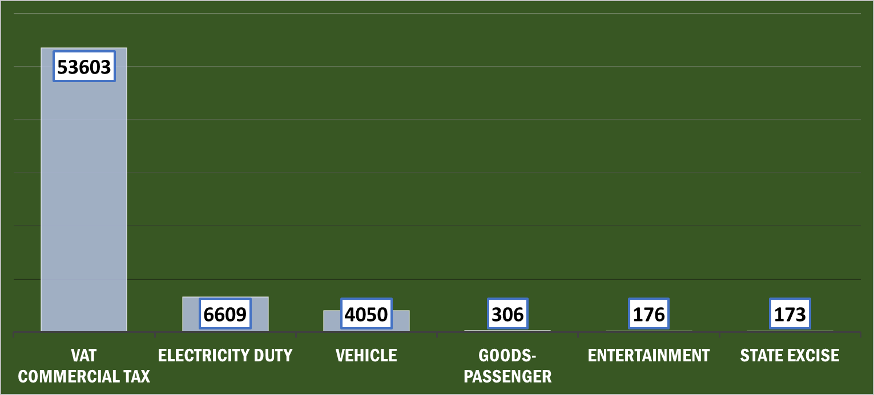

Budget 2017: Indirect Taxes [Rs. Cr]
+ iDT from UT without Legislature
42% Tax
Cess
Surcharge
DEO no share
J&K no share
no share coz assigned to exporter
Gujarat Budget 2017 indirect taxes in decreasing order
UP 18%
Guj 3%

Slide 38
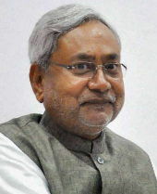
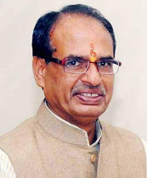
State Excise on liquor (Rs.cr)
Prohibition
Liquor
Notes:
Bhang tax ~100 per kg.
http://finance.bih.nic.in/Budget/Annual-Financial-Statement.pdf
http://www.finance.mp.gov.in/2016/volume1.pdf

Slide 39
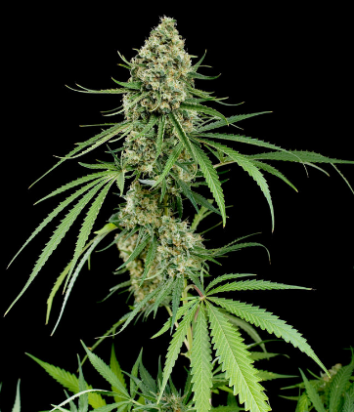
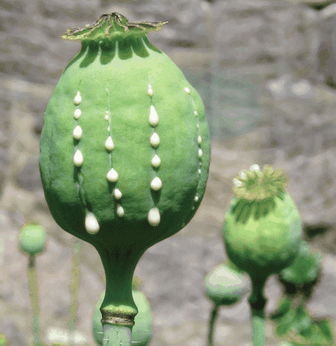

State can levy taxes on Narcotic crops
Opium Poppy (अफ़ीम)
Morphine
Codeine
Thebaine
Heroin (Smack)
Cannabis (भांग)
Hashish
Charas
Ganja
Marijuana
Cultivation Forbidden in India- NDPS Act
Permitted in
Rajasthan, MP,UP

Slide 40
Indirect Tax
Merits
Convenient. no additional paperwork for the customer.
Wider base. Everyone covered.
Less evasion, especially under VAT/GST. (input credit)
Elastic. Small increase brings large revenue
Checks on harmful consumption: cigar, alcohol, even GOLD.
Demerits
Regressive in nature
Both poor and rich taxed equally for the same item
poor people end up paying more portion of their income in indirect taxes.
Single point taxes=high level of corruption, evasion, cascading effect. E.g. sales tax. (Although not in GST/VAT) <more in next lecture>

Slide 41
Indirect Taxes in Budget 2017

Slide 42
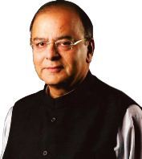
Excise & Customs to boost Make in India?
Custom (import)
▼ raw material
Excise
▲ luxury goods,
▲ Finished goods
▼ intermediate goods
Custom (export)
▲ raw material
▼ finished goods
▼ environmental
▼ renewable energy
▲ Duty inversion
harmful items: Aerated drinks, Tobacco.
As such no major changes, because GST was coming.
And what’re the slabs and classifications in GST-> Next lecture on GST itself.
Notes:
Customs and excise duty structure plays an important role in incentivizing domestic value addition towards Make in India campaig
to make suitable changes in customs and excise duty rates on certain inputs, raw materials, intermediaries and components and certain other goods and simplify procedures

Slide 43
Indirect taxes: (Amount + Tax + Surcharge) + %CESS
Excise on vehicles
Infrastructure Cess (2016):
Excise on Coal
1% to 4% depending on engine cap. (cc)
Clean Environment Cess
Rs.400/tonnes
Service TAX (14%)
0.5% SBC (2015)
Not on public vehicles, e-cars etc.
0.5% KKC (2016)
Here cess is on ‘value of service’, and not on service tax.
= Effective 15%
Notes:
Clean Energy Environment Cess (renamed)
Coal, lignite and peat
Per Tonne: 400/-
1%
small petrol, LPG, CNG cars upto 1200cc
2.5%
diesel cars upto 1500cc
4%
other higher engine capacity vehicles and SUVs.

Slide 44
Service Tax
Theory
Custom act…yes
Central Excise act…yes
Service tax…no (only a chapter in Finance Act)…1994
Article 268-A: empowers union (88th amendment 2003)
J&K…..No [so, FC doesn’t share service tax with them.]
Service provider annual turnover upto 10 lakh…..No. if >10 lakh then collect from customer, pay <hence indirect tax, unlike FBT, Hotel receipt.>
TDS/TCS...No. [customer can’t reclaim tax he paid unlike income tax.] <more in black money lecture>

Slide 45
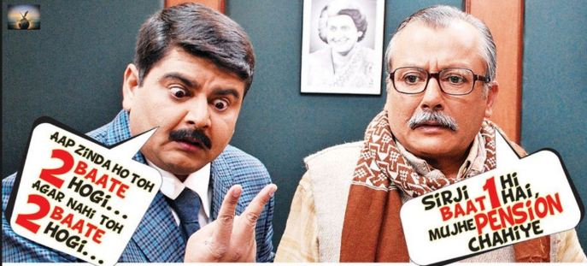
Service tax doesn’t apply to….2 types of lists
Negative List (Statutory in Finance Act itself)
17 categories
RBI service, Foreign diplomatic service in India
Education Service [but not tuition]…… and so on.
Exempted (Gazette)
PM Suraksha Bima; PM Jeevan Jyoti; PM Jan Dhan, Atal Pension
If you want to update, then get parliament (LS) permission.
Parliament permission….X
Notes:
Mutual fund
?
exempt service tax on services provided under Deen Dayal Upadhyay Grameen Kaushalya Yojana and services provided by Assessing Bodies empanelled by Ministry of Skill Development & Entrepreneurship.
exempt service tax on general insurance services provided under ‘Niramaya’ Health Insurance Scheme launched by National Trust for the Welfare of Persons with Autism, Cerebral Palsy, Mental Retardation and Multiple Disability.

Slide 46
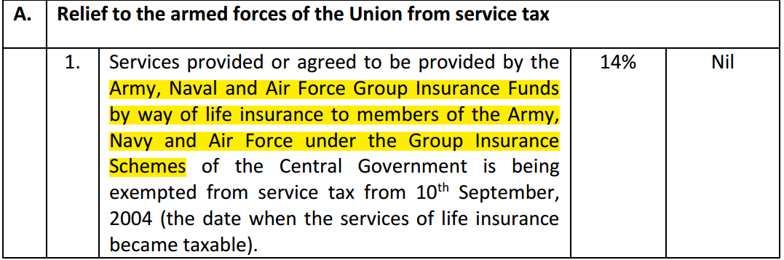
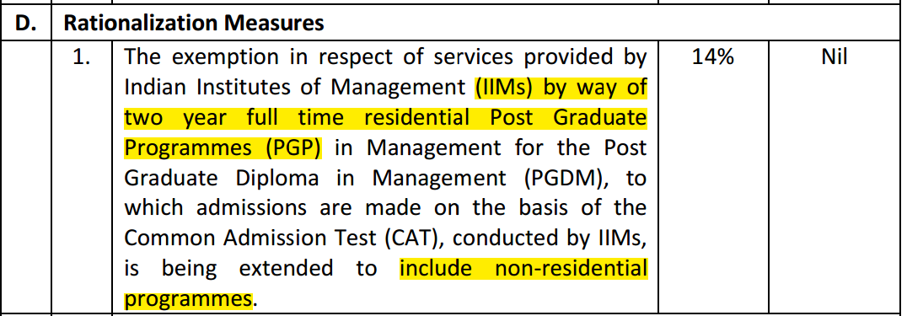
Budget 2017
GST will apply to which services and which are kept out?
NEXT LECTURE ON GST itself

Slide 47

AC Hotel: Service tax; service charge (Jan 2017)
Food item bill
Hotel “service” = Service tax on AC restaurants
Waiter tip = “service charge” [bill + 5-20%]
Compulsory on bill amount
NOT Compulsory. If unsatisfied with service, you can refuse.
Dept of consumer affairs warned.
State VAT on food, beverages
14% [but – 60% “abetment” because goods also]
(ST+ SBC + KKC on 40% of bill amt) = ~6%
5%
Small rest.
18%
12%
Non AC
AC hotels
28%
FIVE STAR
<GST>
Notes:
http://economictimes.indiatimes.com/wealth/spend/is-paying-service-charge-optional/articleshow/56389875.cms

Slide 48

Budget ► Revenue ► Receipt ► Tax
Now lets combine

Slide 49
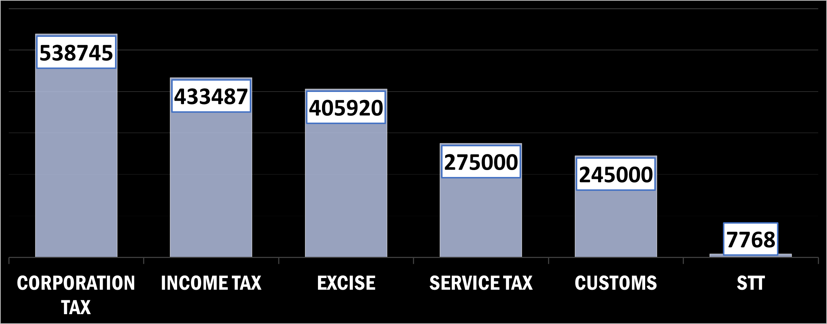


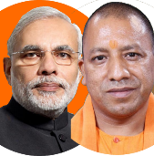
Budget-2017 ► Revenue Receipt ► Tax Revenue (Rs. Cr)
Descending order
Total Collection
Direct Tax> Indirect Tax
(US: 60% voters are IT Payers. Norway-Sweden ~100%)
HW: State fin dep-> your own.
Conclusion: state Indirect tax-highest
Total Collection
Indirect Tax
> Direct Tax
[only 4% voters are IT-Payers ☹]

Slide 50
Mock Question
In which of the following economies, the total amount of revenue collected from direct taxes is higher than the amount collected from indirect taxes.
A country sustaining itself mainly through on tourism and tax havens.
A country with a large diaspora abroad and high volume of inward remittances.
A developing country.
A developed country.

Slide 51
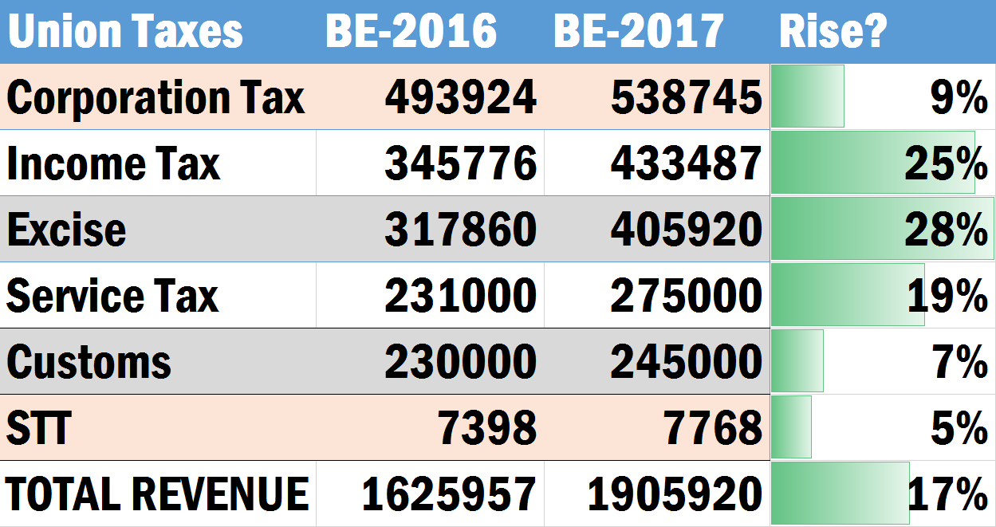
Budget 2016 vs. 2017: Revenue-Estimates (cr.)
[upto 50cr]
~30%-> 25%
Demonetization
Tighter rules
Mk.in India = ▲
Income tax 5%
=~15,500 cr. with consumers
1 April 2016
31st March 2017
1 April 2017
31st March 2018
Mk.in India = Import ▼
Trumpism = Export ▼
Union Total DT >> iDT
But [Union+ States] = iDT >> DT

Slide 52

Advance tax and Revenue Shortfall?
Estimated Total income: 1000 cr.
Advance Tax liability: 100 cr.
FY
2016-17
Q1: April-June
Q2
Q3
Q4
July-Sept
Oct-Dec
Jan-March
15th Mar:
100 cr.
15th June:
15 cr.
15th Dec:
75 cr.
15th Sept:
45 cr.
But what if film flops and makes only 700 cr.!!

Slide 53
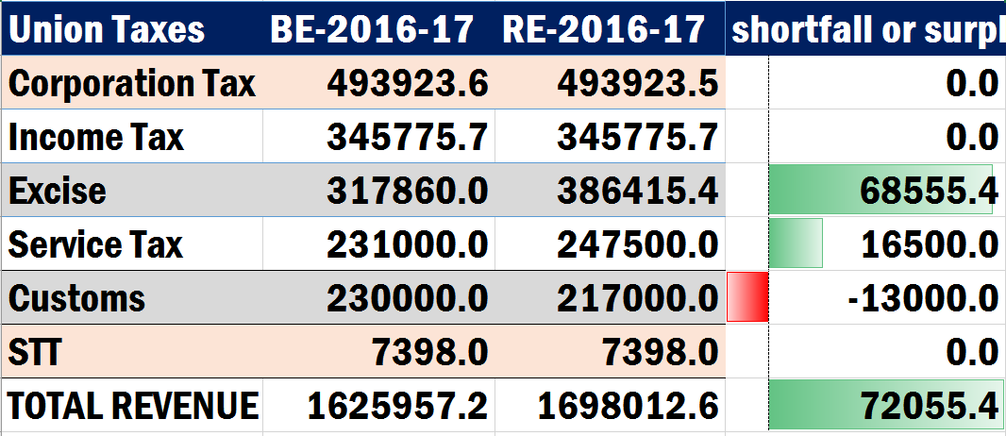
Revenue shortfall?
Presented with budget 2017-18
Black money as ‘mfg’..?
97% SBN returned!
1 April 2016
31st March 2017

Slide 54
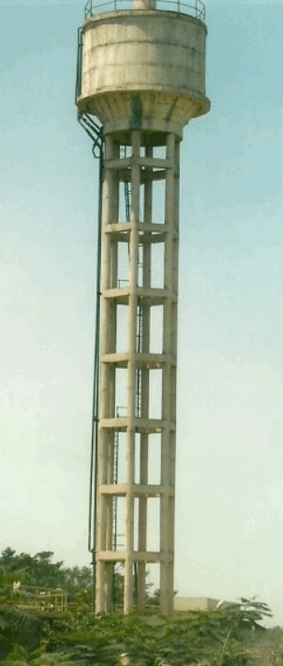
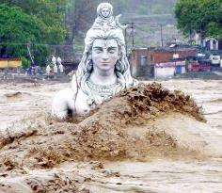
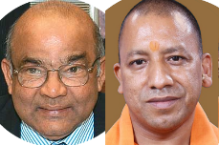
Budget 2017
Direct
Taxes
9.8Lcr
Indirect
Taxes
9.2Lcr
UT w/o
Legi.
4k cr
Gross Tax Revenue
एकंदर महेसुल आवक
19 lakh crore.
MINUS
NCCF under MHA (Public Account)
10,000 Cr.
States’ share
6.7 L cr.
NET Tax Revenue : चोख्खी महेसुल आवक: 12.2 L cr.
Notes:
Gross Tax Revenue 16.3L Cr.
Ekandar mehsul awak
Sakal rajaswa aay
Less - NCCD transferred to the National Calamity Contigency Fund/National Disaster Response Fund

Slide 55
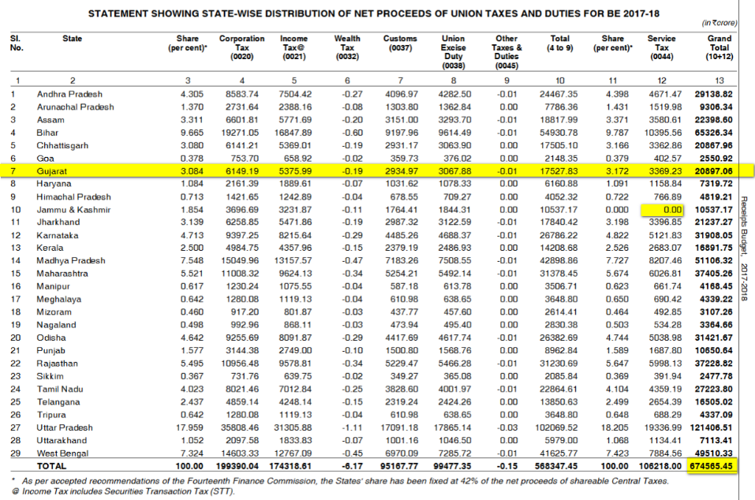
Union Budget 2017: 42% Verticle devolution of Taxes (14th FC)
Horizontal Distr. Variables:
1) Census 1971: Population
2) Census 2011: Demographic Change
3) Income-Distance from Best States
4) Area
5) Forest-Cover

Slide 56
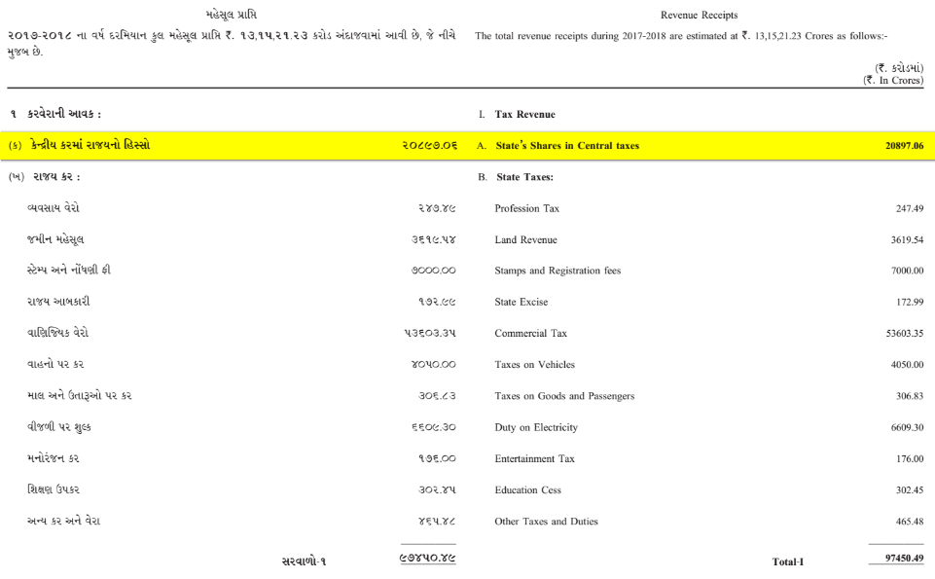

Let’s crosscheck with Gujarat State Budget 2017
Self study 14th FC: video link

Slide 57
Budget ► Revenue ► Receipt ► Tax
UBI?
Then GST-> Blackmoney > Demonetization
Fiscal Deficit: FRBM Panel?

